Slide 1
CHAPTER 1
SCSI1013: Discrete Structures
SET THEORY
[Part 1: Set & Subset]
2014/2015 – Sem. 1

Slide 2
Introduction
Why are we studying sets
  The concept of set is basic to all of mathematics and mathematical applications.
  Serves as a basis of description of higher concept and mathematical reasoning
  Set is fundamental in many areas of Computer Science.
  For us, sets are useful to understand the principles of counting and probability theory

Slide 3
Sets
Sets
The concept of set is basic to all of mathematics and mathematical applications.
A set is a well-defined collection of distinct objects.
These objects are called members or elements of the set.

Slide 4
Sets
Sets
Well-defined means that we can tell for certain whether an object is a member of the collection or not.
If a set is finite and not too large, we can describe it by listing the elements in it.

Slide 5
Example
example
A is a set of all positive integers less than 10,
A={1, 2, 3, 4, 5, 6, 7, 8, 9}
B is a set of first 5 positive odd integers,
B={1, 3, 5, 7, 9}
C is a set of vowels, C={a, e, i, o, u}

Slide 6
Defining Sets
This can be done by:
  Listing ALL elements of the set within braces.
  Listing enough elements to show the pattern then an ellipsis.
  Use set builder notation to define “rules” for determining membership in the set.

Slide 7
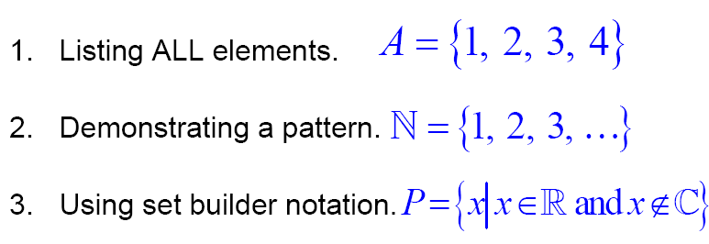
Example
explicitly
implicitly
implicitly

Slide 8
Sets
Sets
A set is determined by its elements and not by any particular order in which the element might be listed.
Example,
  A={1, 2, 3, 4},
A might just as well be specified as
{2, 3, 4, 1} or {4, 1, 3, 2}

Slide 9
Sets
Sets
The elements making up a set are assumed to be distinct, we may have duplicates in our list, only one occurrence of each element is in the set.
Example
{a, b, c, a, c} {a, b, c}
{1, 3, 3, 5, 1} {1, 3, 5}

Slide 10
Sets
Sets
Use uppercase letters A, B, C … to denote sets, lowercase denote the elements of set.
The symbol ∈ stands for ‘belongs to’
The symbol ∉ stands for ‘does not belong to’

Slide 11
Example
example
X={ a, b, c, d, e }, b∈X and m∉X
A={{1}, {2}, 3, 4}, {2}∈A and 1∉A

Slide 12
Sets
Sets
If a set is a large finite set or an infinite set, we can describe it by listing a property necessary for memberships
Let S be a set, the notation,
A= {x | x ∈S, P(x)} or A= {x ∈S | P(x)}
means that A is the set of all elements x of S such that x satisfies the property P.

Slide 13
Example
example
Let A={1, 2, 3, 4, 5, 6}, we can also write A as,
A={x | x ∈Z, 0< x <7}
if Z denotes the set of integers.
Let B={x | x∈Z, x>0}, B={1, 2, 3, 4, …}

Slide 14
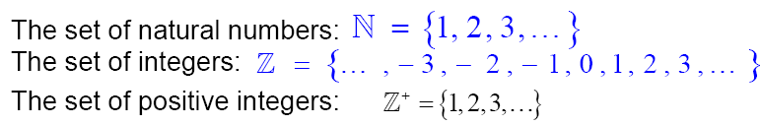
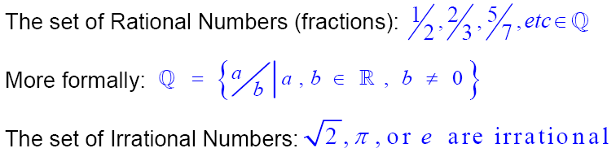

Example
example

Slide 15
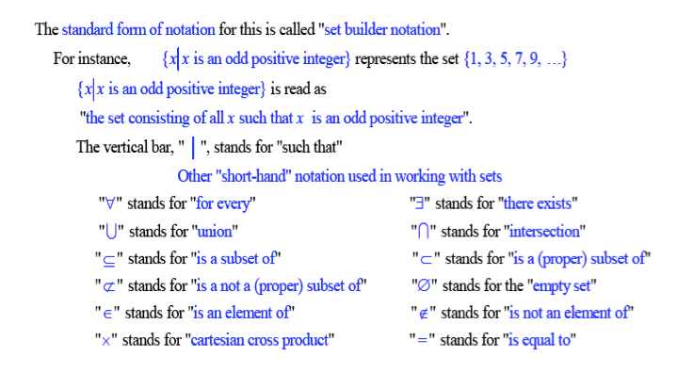
Some Symbols Used With Set Builder Notation

Slide 16
Subset
If every element of A is an element of B, we say that A is a subset of B and write A ⊆ B.
A=B, if A ⊆ B and B ⊆ A
The empty set (∅) is a subset of every set.

Slide 17
Example
A={1, 2, 3}
Subset of A,
∅, {1}, {2}, {3}, {1, 2}, {1, 3}, {2, 3} {1, 2, 3}
Note:
A is a subset of A

Slide 18
Exercise
Answer true or false
{x} ⊆ {x}
{x} ∈ {x}
{x} ∈ {x,{x}}
{x} ⊆ {x,{x}}

Slide 19
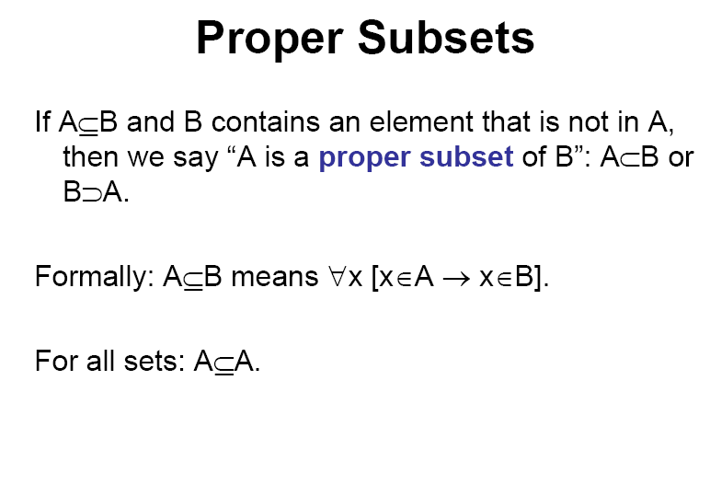
Note: If A is a subset of B and A does not equal B, we say that A is a proper subset of B (A ⊆ B and A≠B (B ⊄ A))

Slide 20
Example
A={1, 2, 3}
Proper subset of A,
∅, {1}, {2}, {3}, {1, 2}, {1, 3}, {2, 3}
Note:
A proper subset of a set A is a subset of A that is not equal to A ( {1,2,3} ⊄ A)

Slide 21
Example
Let a set, B={1, 2, 3, 4, 5, 6} and the subset,
A = {1, 2, 3}.
A is proper subset of B.

Slide 22
Example
A={a,b,c,d,e,f,g,h}
B={b,d,e}
C={a,b,c,d,e}
D={r,s,d,e}
Proper subset of A ??
B and C

Slide 23
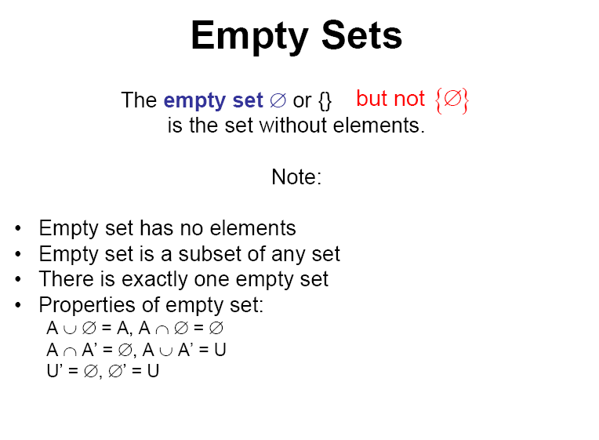

Slide 24
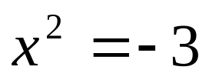
Example
  = {x | x is a real number and }
  ∅ = {x | x is positive integer and x³ < 0}

Slide 25
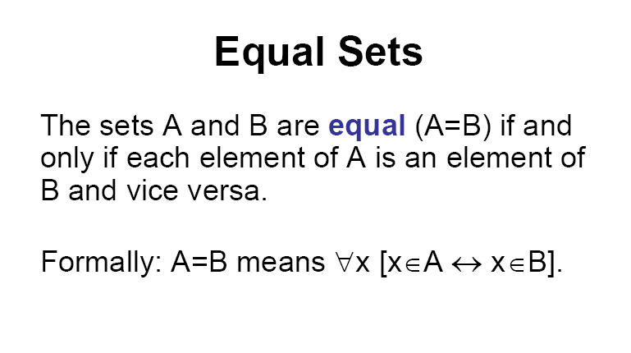

Slide 26
Example
  A={a, b, c}, B={b, c, a}, A=B
  C={1, 2, 3, 4}
  D={x | x is a positive integer and 2x < 10},
  C=D

Slide 27
Exercise
Determine whether each pair of sets is equal
{1, 2, 2, 3}, {1, 3, 2}
{ x | x ² + x = 2}, {1, -2}
{x | x is a real number and 0< x ≤2}, {1,2}

Slide 28
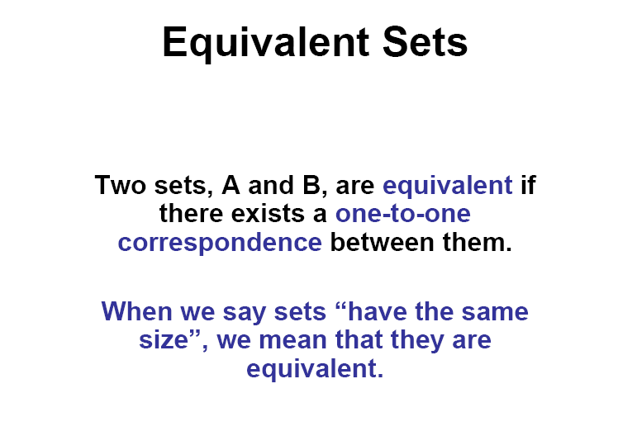

Slide 29
Example
Set A: {A, B, C, D, E} and Set B: {1, 2, 3, 4, 5}
Note:
An equivalent set is simply a set with an equal number of elements.
The sets do not have to have the same exact elements, just the same number of elements.

Slide 30
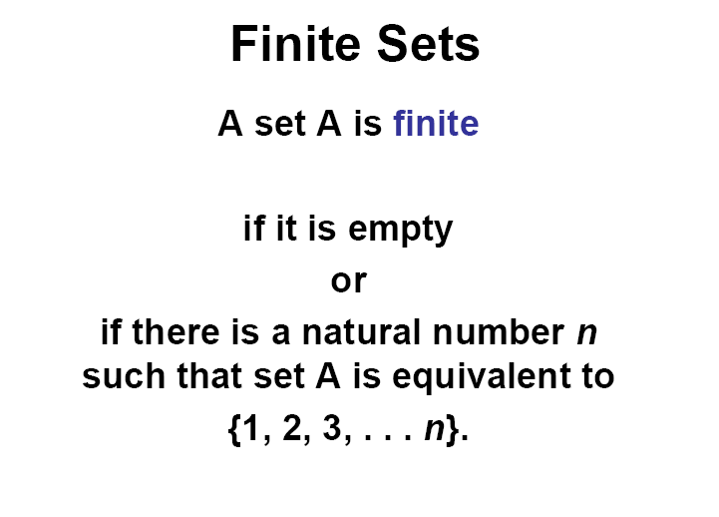

Slide 31
Example
  A= {1, 2, 3, 4}
  B = {x | x is an integer, 1 < x < 4}
Note:
  There exists a nonnegative integer n such that A has n elements (A is called a finite set with n elements)

Slide 32
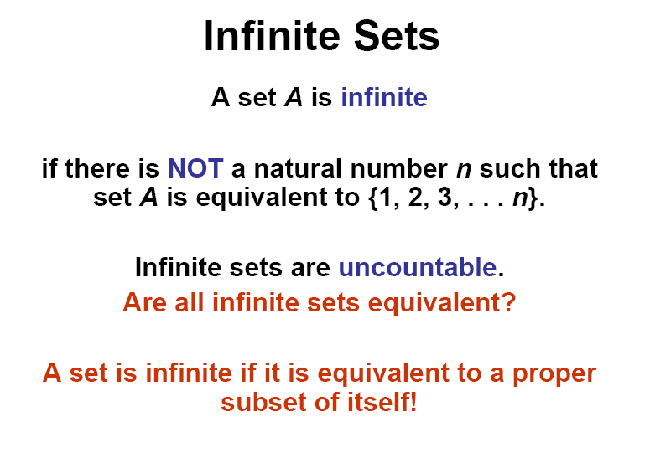

Slide 33
Example
  Z = {x| x is an integer}
  or Z = {…, -3, -2, -1, 0, 1, 2, 3,…}
  S={x| x is a real number and 1 < x < 4}

Slide 34
Example
C = {5, 6, 7, 8, 9, 10} (finite set)
B = {x | x is an integer, 10 < x < 20} (finite set)
D = {x | x is an integer, x > 0} (infinite set)

Slide 35
Universal Set
Sometimes we are dealing with sets all of which are subsets of a set U.
This set U is called a universal set or a universe.
The set U must be explicitly given or inferred from the context.

Slide 36
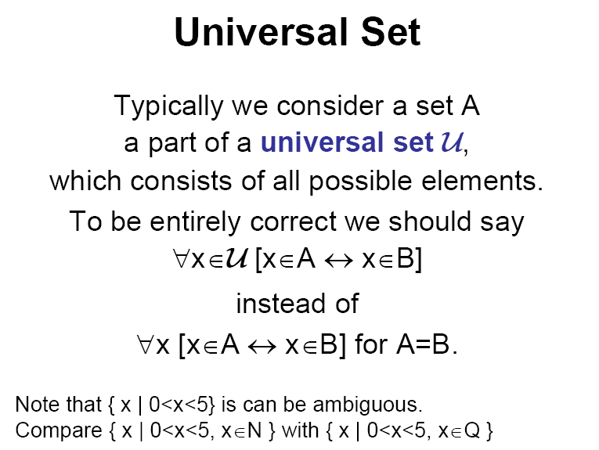

Slide 37
Example
The sets A={1,2,3}, B={2,4,6,8} and C={5,7}
One may choose U={1,2,3,4,5,6,7,8} as a universal set.
Any superset of U can also be considered a universal set for these sets A, B, and C.
For example, U={x | x is a positive integer}

Slide 38
Cardinality of Set
Let S be a finite set with n distinct elements, where n≥0.
Then we write |S|=n and say that the cardinality (or the number of elements) of S is n.
Example
A= {1, 2, 3}, |A|=3
B= {a,b,c,d,e,f,g}, |B|=7

Slide 39
Exercise
If M is finite, determine the |M|
  If M= {1, 2, 3, 4}
  If M = {4, 4, 4}
  If M= {}
  If M= {ø,{ø}, {ø, {ø}}}

Slide 40
Power Set
The set of all subsets of a set A, denoted P(A), is called the power set of A.
P(A)= {X | X ⊆ A}
If |A|=n, then |P(A)| = 2^{n}

Slide 41
Example
A={1,2,3}
The power set of A,
P(A)= {∅, {1}, {2}, {3}, {1,2}, {1,3}, {2,3}, {1,2,3} }
Notice that |A| = 3, and |P(A)| = 2³ = 8

Slide 42
Exercise
Let X= {1, 2, 2, {1}, a}
Find:
  |X|
  Proper subset of X
  Power set of X

Slide 43
Exercise
List the member of P({a, b, c, d}). Which are proper subset of {a, b, c, d}?

Slide 44
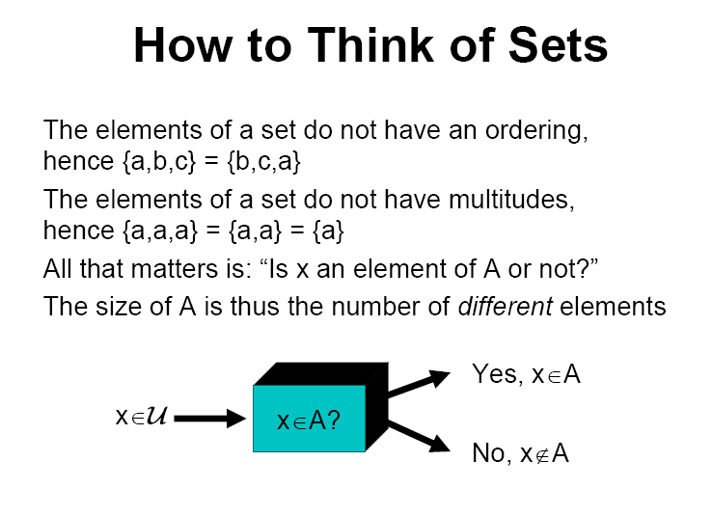
Summary

